Slide 1
Machine learning
Modern solution – modern thinking

Slide 2
How to start?
Image recognition
Text recognition
Reinforcement learning

Slide 3
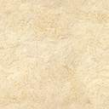
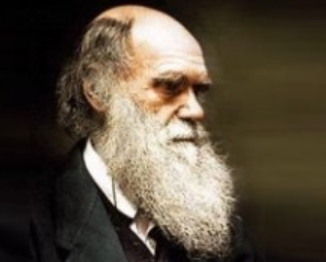
REINFORCEMENT LEARNING
EVOLUTION
EVOLUTION
EVOLUTION
EVOLUTION
EVOLUTION

Slide 4
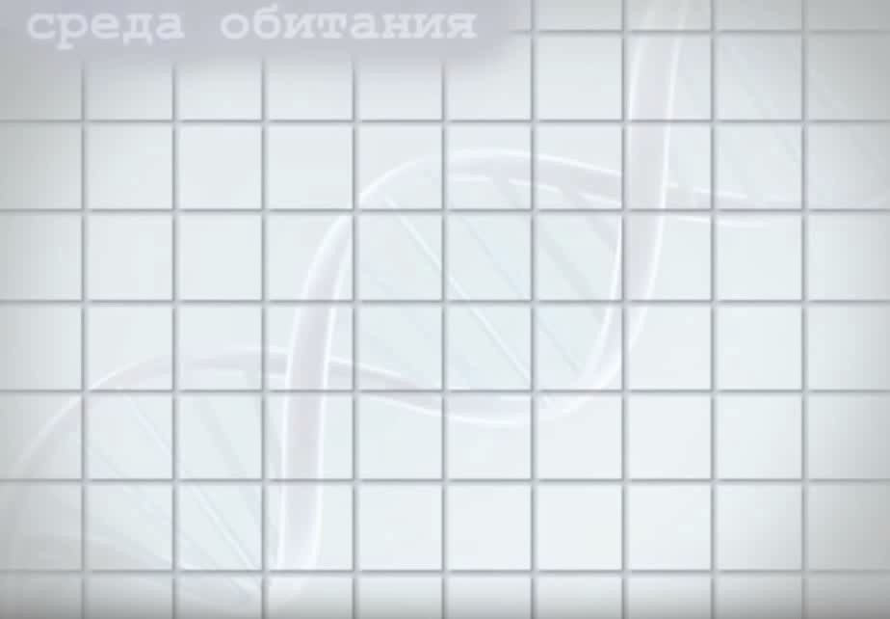

Slide 5
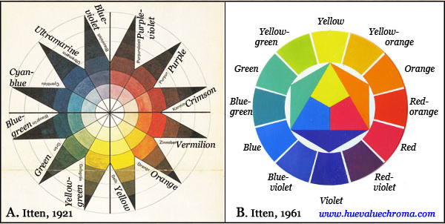
COLOR ITTEN’S THEORY

Slide 6
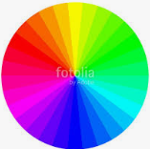
RGB CIRCLE
Receive color and to do next :
For R = 256 – color R
For G = 256 – color G
For B = 256 – color B

Slide 7
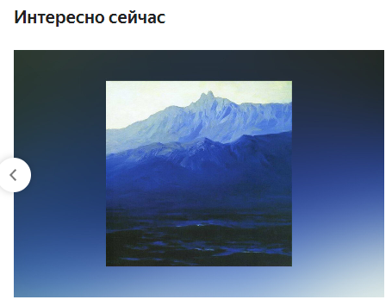

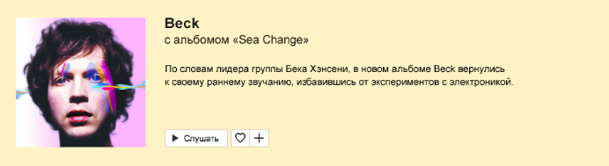
Item Colors

Slide 8
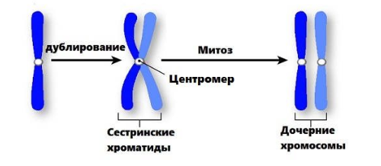
Chromatic pairs

Slide 9
How to repeat?
Parse all colors and get from it 50%
Combine all colors as Aa, AA, aa, aA
Drop AA, aA, aa
For Aa create Itten’s pairs
Just draw it

Slide 10
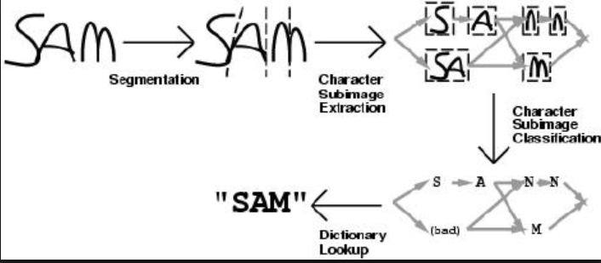
TEXT RECOGNITION
Vectors
Vectors
Vectors

Slide 11

Image recognition

Slide 12
Define elements aka image recognition
Resize source image to 8x8 (64 pixels)
Move source image to gray gradation
Receive average of brightness
Create threshold of image
Create hash
Compare with expected image using a Hamming length (unnecessary)

Slide 13
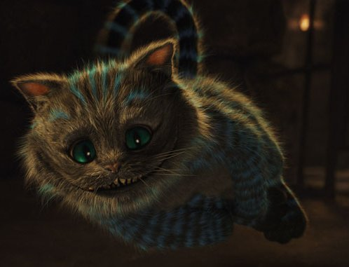
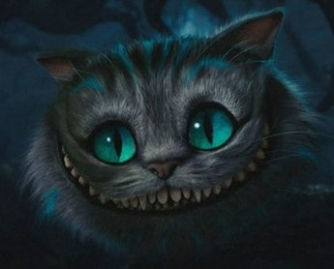
Let’s compare these cats

Slide 14



Average: 36.88
Hash: 2BE2E8E3D3CB0
Threshold
Source image
Resize 8x8
Gray
gradation
Average: 30.69
Hash: 48847E5536130C10
Hamming distance is 25
0 = equal
40 = not equal

Slide 15
GL & HF
Marat Zimnurov

